Slide 1
Dynamic Modeling and Friction
Goal: Introduce the mathematical foundation of the robot's physical model.

Slide 2
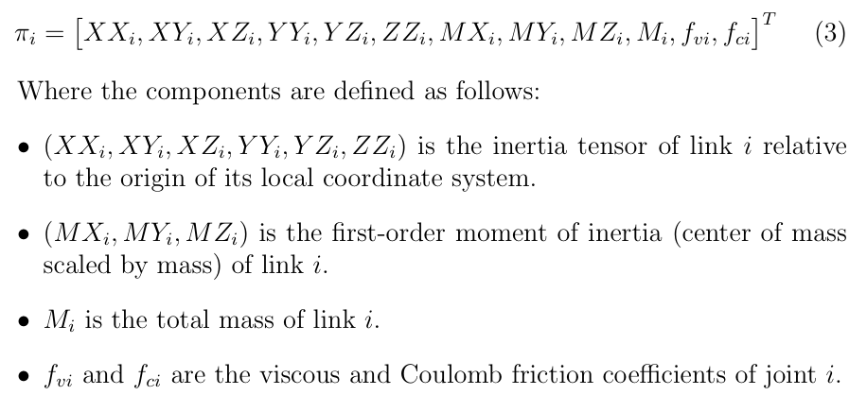
Dynamic Modeling and Friction
What parameters to be determined?

Slide 3
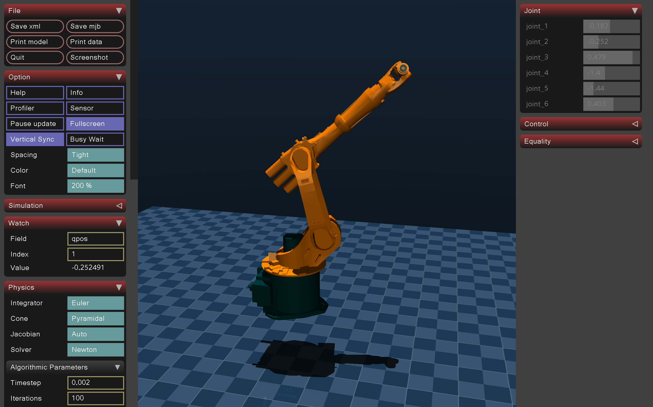
MuJoCo
Pristine Algorithmic Environment:
Traditional game-engine simulators prioritize rendering speed over mathematical precision, which inherently introduces numerical "jitter."
MuJoCo, however, provides exact mechanical states and applied torques
Superior Friction and Contact Mechanics:
MuJoCo natively enforces strict physical constraints and allows for the explicit, precise definition of non-linear joint resistances

Slide 4
MuJoCo
How the environment was made as realistic as possible?
injected viscous damping (damping="5.0") and Coulomb friction (frictionloss="5.0") into the massive base links
scaling them down proportionally to 0.1 for the ultra-light distal joints.

Slide 5

Pinocchio is a highly specialized, open-source C++ library (with robust Python bindings) dedicated to rigid multi-body dynamics.
An engine that rapidly calculates the robot's kinematics and dynamics.
built upon the foundational mathematical framework of Roy Featherstone's Spatial Algebra
Unmatched Computational Speed

Slide 6
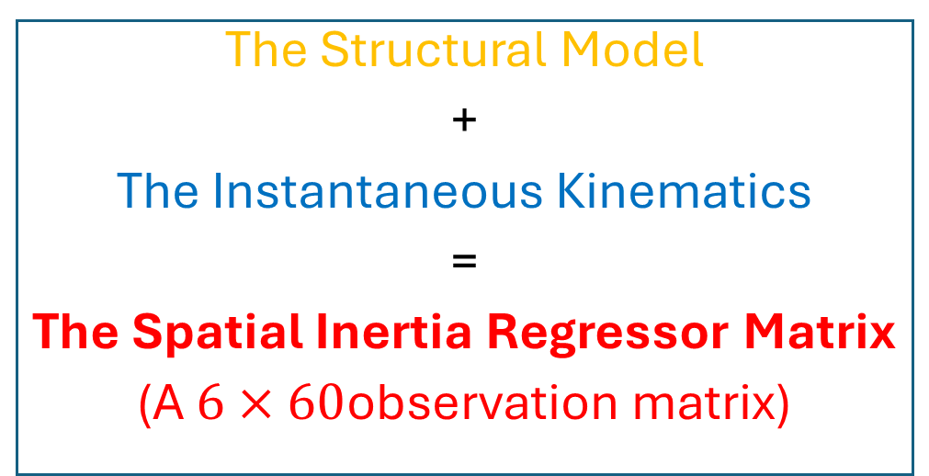
Role
was utilized specifically to bypass the massive, highly complex symbolic algebra traditionally required to derive robot dynamics.
was used to programmatically evaluate the inverse dynamic identification model at every single time step using
pin.computeJointTorqueRegressor.
The Structural Model
+
The Instantaneous Kinematics
=
The Spatial Inertia Regressor Matrix
(A $6×60$observation matrix)

Slide 7
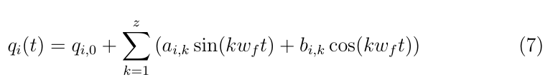
Excitation Trajectory Design
1. Finite Fourier Series Trajectories
Number of Harmonics = 5
wf = 2π(2/65) rad/s
continuous trajectory period = 32.5 seconds

Slide 8
Excitation Trajectory Design
2. Trajectory Optimization and Constrained Search
The Algorithm: The Sequential Least Squares Programming (SLSQP) algorithm Hard Wall Penalties: Massive mathematical penalties protected the hardware by explicitly preventing base collisions and kinematic saturation.
Motion Quality: The solver actively prevented high-frequency micro-vibrations by demanding wide spatial variance and explicitly rewarding aggressive distal joint velocities.

Slide 9
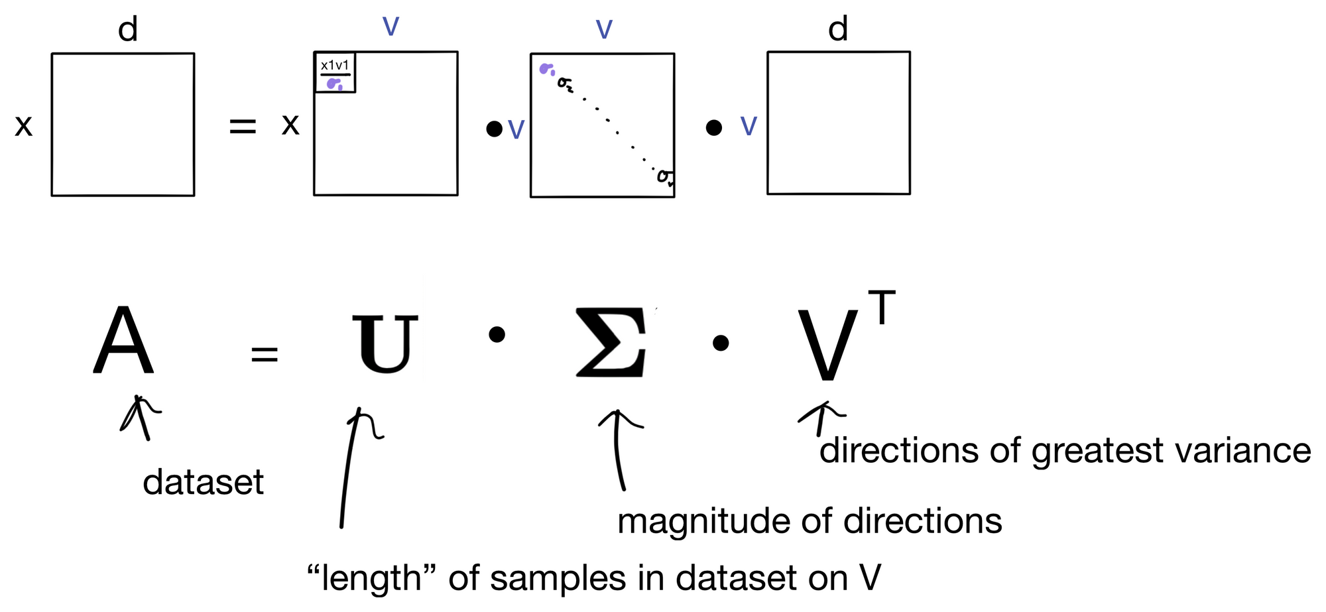
Excitation Trajectory Design
2. Trajectory Optimization and Constrained Search

